Slide 1
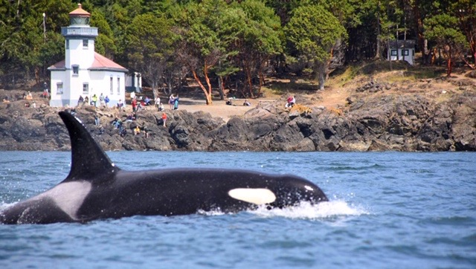
Shifts in southern resident killer whale phenology in the Salish Sea
Ailene K. Ettinger
NRC Research Associate
CB Division Meeting
August 14, 2019

Slide 2
Shifts in southern resident killer whale phenology in the Salish Sea
Mentors/coauthors/collaborators
Jameal Samhouri
Chris Harvey
Candi Emmons
Jennifer Olson
Brad Hanson
Eric Ward
Ole Shelton
Ailene K. Ettinger
NRC Research Associate
CB Division Meeting
August 14, 2019

Slide 3
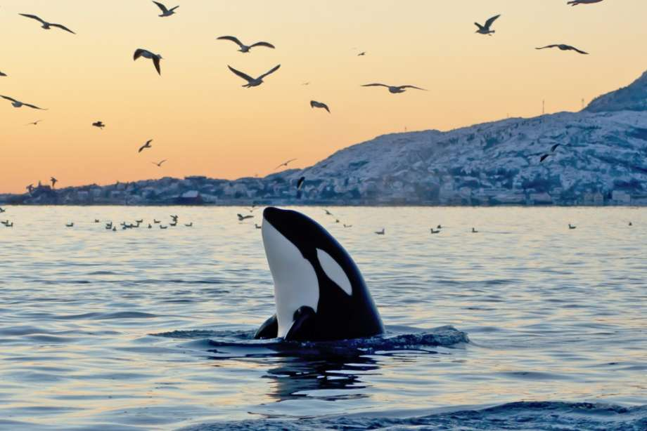
Southern resident killer whales (Orcinus orca) are an endangered population
Killer whales are widespread, with different populations
Resident killer whales = fish-eating
Southern residents (SRKWs) listed as endangered in 2005
3 pods: J,K,L
Threats have included shooting, live capture, lack of food, vessel noise, pollution, small
Notes:
Recent news on SRKWs
Many people tie changes in SRKW sightings to changes in salmon

Slide 4
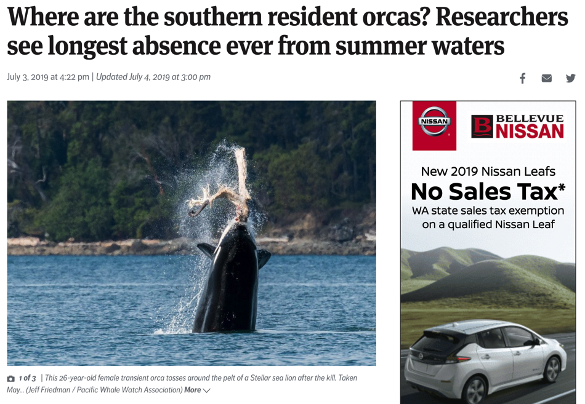
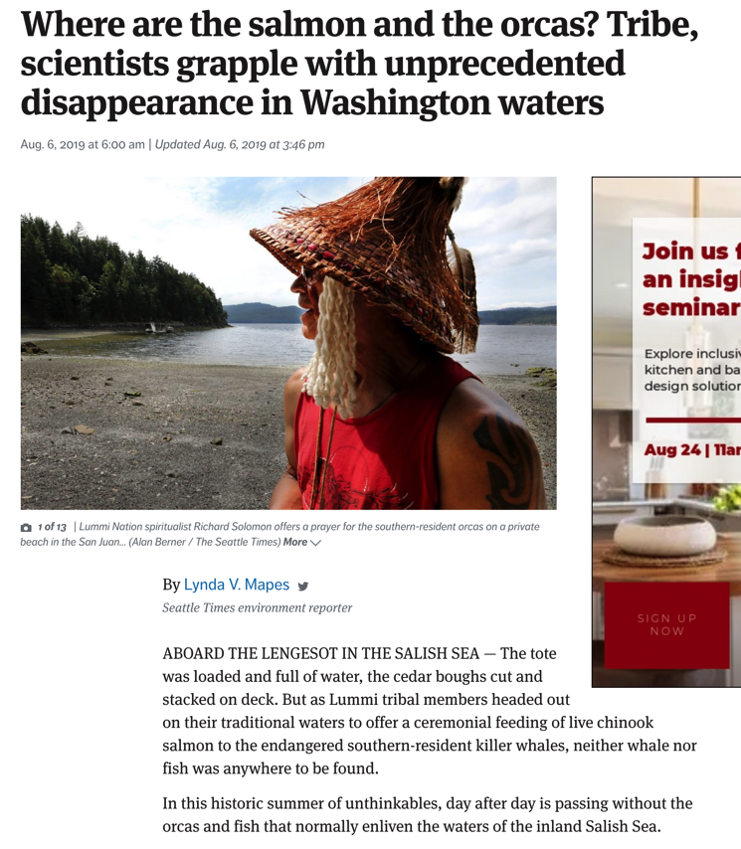
Southern resident killer whales may be shifting their activity in the Salish Sea
Notes:
Recent news on SRKWs
Many people tie changes in SRKW sightings to changes in salmon

Slide 5
Are these recent events part of long-term phenological shifts?
Notes:
Long-term vs temporary changes?
in SRKW activity in the Salish Sea
Later arrival, earlier departure, both?
Understanding the details of this phenomena will improve our ability to manage SRKWs

Slide 6
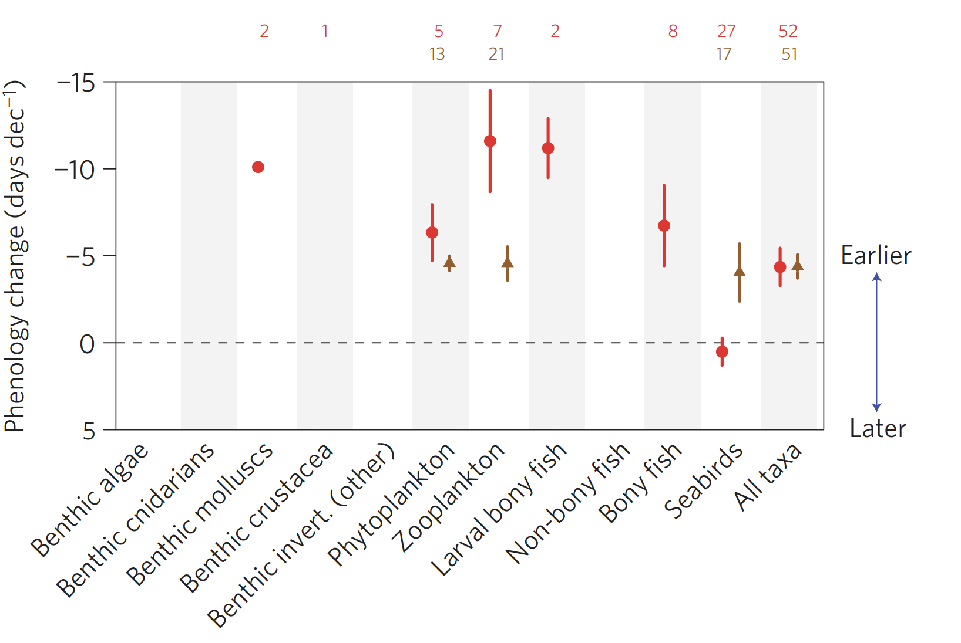
Are these recent events part of long-term phenological shifts? Many marine organisms are shifting phenology
Poloczanska et al 2013
Notes:
Many marine organisms have shifted their phenology earlier, as would be expected in many cases with climate change. Figure from a meta-analysis of marine studies documenting shifts in time (negative is earlier), across diverse taxonomic groups.

Slide 7
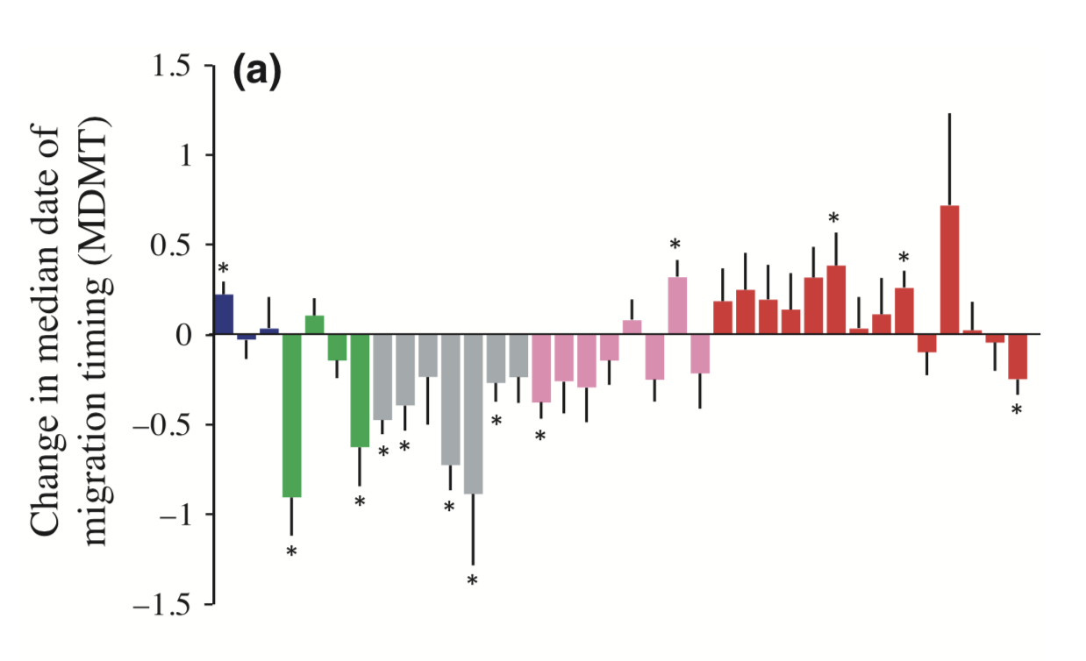
Are these recent events part of long-term phenological shifts? Many salmon species are shifting phenology
Later
Earlier
Kovach et al 2015
Notes:
On the west coast, several recent studies have documented shifts in salmon phenology- especially the timing of adult returns to their natal streams.
This study is in southeast Alaska and shows 5 different salmon species
Blue=chinook, creen= chum. grey= coho, pink= pink, red = sdockeye

Slide 8
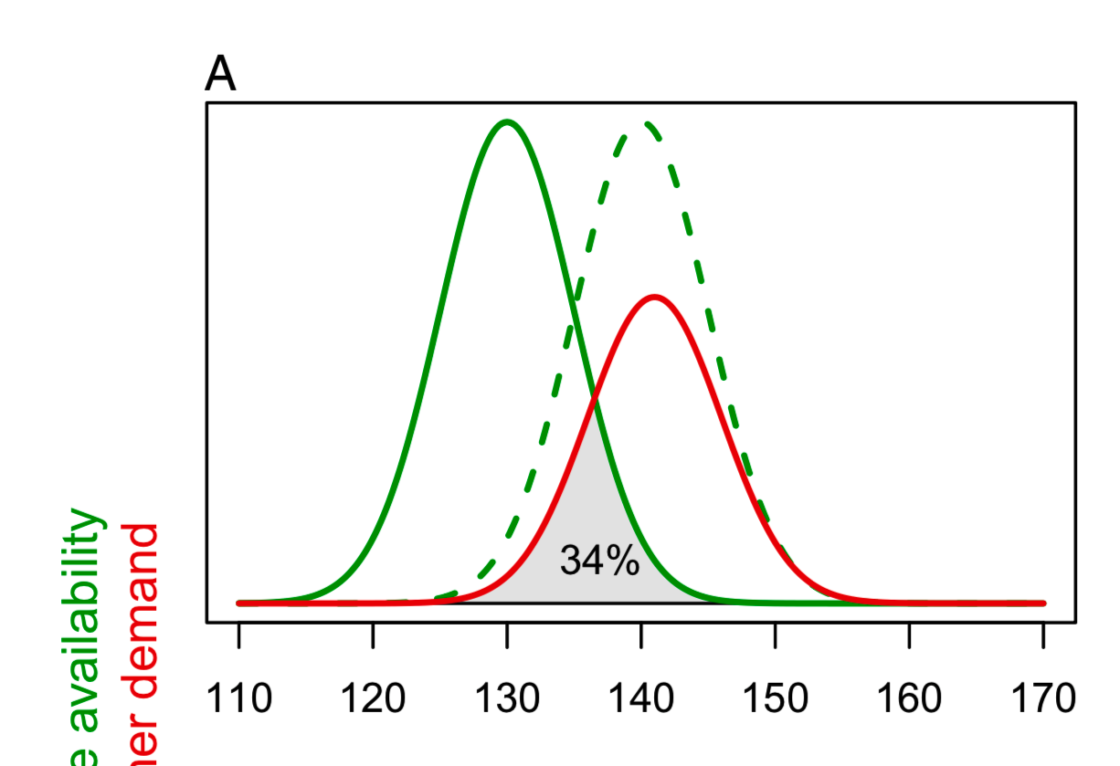
Asynchronous shifts between SRKWs and their prey could reduce prey availability (phenological “mismatch”)
Prey availability
Consumer demand
Day of year
Linden 2018
Notes:
Add slide about Olson paper with state of what we know, knowledge gaps
Add a gaps and hypotheses slide-
(colored table from olson slide)
Suggestions that all three pods spending more time in inland waters – done at a coarse scale,
Open question about whether timing of whales in the sound has shifted:
Alternative hypotheses: Effort has also shifted- is it just an arttifat?
Or prey have shifted
Is there pattern in the time of day when SRKWs move ? (Chris
Admiralty inlet over and over
One of the implications of these variable rates is that interacting species may respond asynchronously. Such mismatches can cause

Slide 9
Can we detect phenological shifts in SRKW activity in the Salish Sea?
Notes:
Long-term or short-term shifts?
This would be useful to know, especially in comparison to potential shifts in salmon phenology, as on of the strategies considered by the SRKW task force is increasing salmon production.

Slide 10
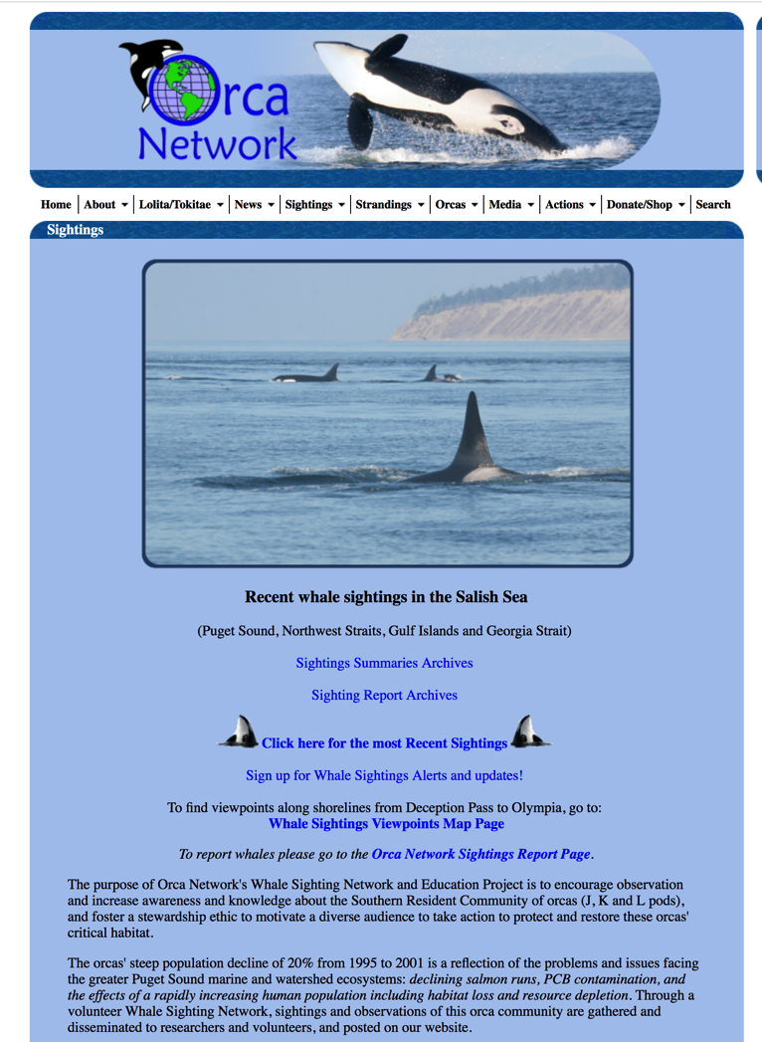
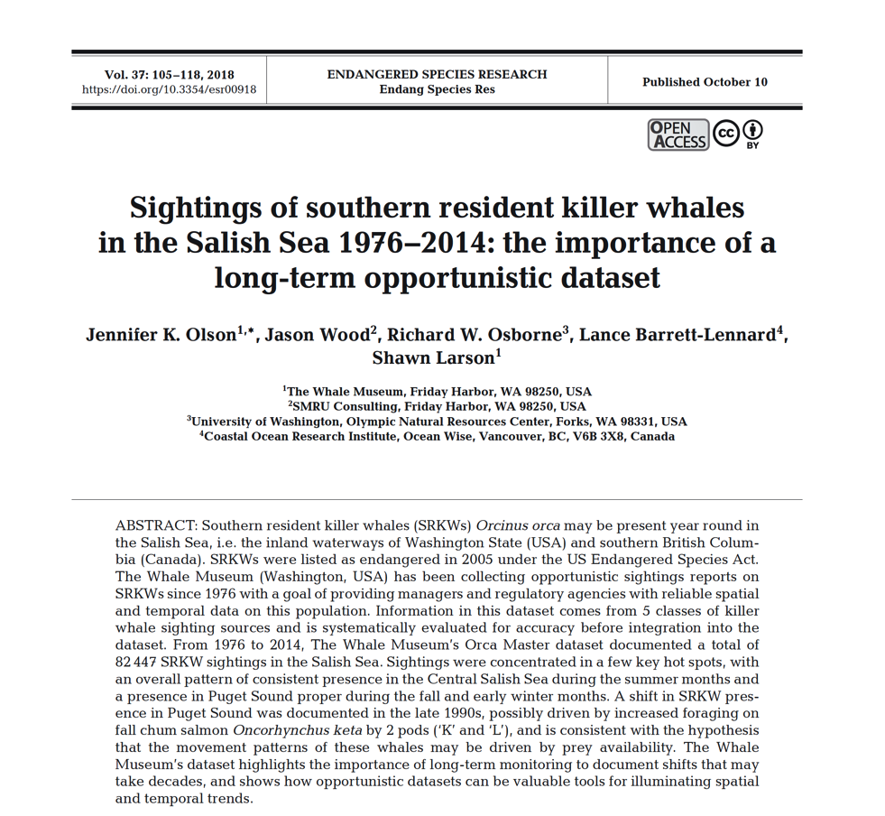
The Orca Master Database
Mean obs date
Duration of season
Notes:
Best source of long-term data on SRKW activity in our region= OrcaMaster Database
This is a great resource of compiled data from public sighting records, whale watch boats, sound watch personal, lime kiln research station, and satellite tracking units

Slide 11
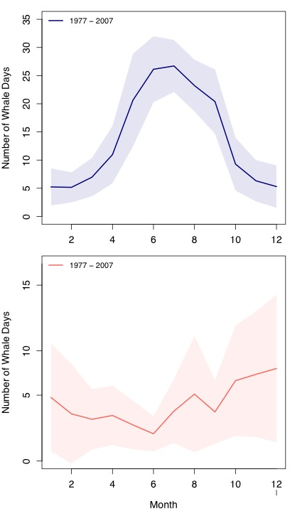
SRKW activity varies seasonally across two areas
Central Salish Sea
(Summer)
Puget Sound Proper
Fall/Winter
Source: OrcaMaster Database
Notes:
If we want to look at long-term trends in phenology using this dataset there are several things to keep in mind:
First, sightings vary seasonally across two broad areas within our region:
an overall pattern of consistent presence in the Central Salish Sea during the summer months and
a presence in Puget Sound proper during the fall and early winter months.

Slide 12
SRKW activity varies seasonally across two regions, that may have divergent long-term trends
Mean obs date
Duration of season

Slide 13
SRKW activity varies seasonally across two regions that may have divergent long-term trends
Mean obs date
Duration of season
Notes:
These two regions are weakly correlated (slope = 0.13, p=0.09)- i.e., a year with high numbers of whale days in the Central Salish Sea on average is more likely to have higher numbers of whale days in Puget Sound- but with low explanatory power. Makes sense to treat these two regions
differently

Slide 14
SRKW activity varies seasonally across two regions, that may have different long-term trends and varying effort
Mean obs date
Duration of season
Notes:
It is important to acknowledge or account for effort in any analyses of long-term trends using the Orca Master database

Slide 15
We used multi-level occupancy models to estimate daily probability of occupancy
Notes:
We analyzed as the response in our models the number of times that a pod was detected per spatiotemporal unit (fishing area and day) among the total number of sightings for that fishing area (which was equal to the number of sightings submitted for the unit).
We used occupancy models to estimate jointly the proportion of fishing areas occupied (i.e. a species’ distribution, or the
area where abundance Ni is greater than 0) and detection probability (the probability to detect at least one of the Ni individuals present at fishing areai).
We parameterized the model with annual occupancy probabilities
The distribution submodel distinguishes the latent state of occurrence, that is, true presence or absence, zi,j, of a pod in fishing area i = 1,...,R in year j = 1,...,T, such that zi,j = 0 denotes a fishing area where a species is absent during a year and zi,j = 1 where it is present. We assumed zi,j to be a Bernoulli random variable with the year-specific occupancy probability wj as success parameter.
zi;j BernoulliðwjÞ
To account for an observation process with imperfect detection and
no false-positive errors, the number of surveys in quadrat i at day d and
year j in which the target species was detected (yi,d,j) among the total
number of surveys made in i, d and j (Ti,d,j) was modelled as binomial
random variables with success parameter depending on the product of
the state of occurrence, zi,j, and of detection probability, pd,j, for day d
and year j.

Slide 16
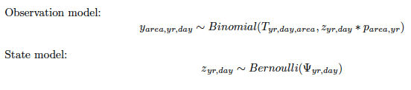
We used multi-level occupancy models to estimate daily occupancy probability
Notes:
We analyzed as the response in our models the number of times that a pod was detected per spatiotemporal unit (fishing area and day) among the total number of sightings for that fishing area (which was equal to the number of sightings submitted for the unit).
We used occupancy models to estimate jointly the proportion of fishing areas occupied (i.e. a species’ distribution, or the
area where abundance Ni is greater than 0) and detection probability (the probability to detect at least one of the Ni individuals present at fishing areai).
We parameterized the model with annual occupancy probabilities
The distribution submodel distinguishes the latent state of occurrence, that is, true presence or absence, zi,j, of a pod in fishing area i = 1,...,R in year j = 1,...,T, such that zi,j = 0 denotes a fishing area where a species is absent during a year and zi,j = 1 where it is present. We assumed zi,j to be a Bernoulli random variable with the year-specific occupancy probability wj as success parameter.
zi;j BernoulliðwjÞ
To account for an observation process with imperfect detection and
no false-positive errors, the number of surveys in quadrat i at day d and
year j in which the target species was detected (yi,d,j) among the total
number of surveys made in i, d and j (Ti,d,j) was modelled as binomial
random variables with success parameter depending on the product of
the state of occurrence, zi,j, and of detection probability, pd,j, for day d
and year j.

Slide 17
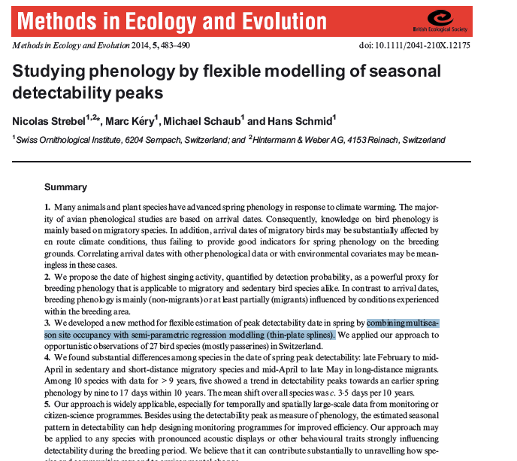
We used multi-level occupancy models to estimate daily occupancy probability
Occupancy modelled as a function of year and date, using splines.
Notes:
We analyzed as the response in our models the number of times that a pod was detected per spatiotemporal unit (fishing area and day) among the total number of sightings for that fishing area (which was equal to the number of sightings submitted for the unit).
We used occupancy models to estimate jointly the proportion of fishing areas occupied (i.e. a species’ distribution, or the
area where abundance Ni is greater than 0) and detection probability (the probability to detect at least one of the Ni individuals present at fishing areai).
We parameterized the model with annual occupancy probabilities
The distribution submodel distinguishes the latent state of occurrence, that is, true presence or absence, zi,j, of a pod in fishing area i = 1,...,R in year j = 1,...,T, such that zi,j = 0 denotes a fishing area where a species is absent during a year and zi,j = 1 where it is present. We assumed zi,j to be a Bernoulli random variable with the year-specific occupancy probability wj as success parameter.
zi;j BernoulliðwjÞ
To account for an observation process with imperfect detection and
no false-positive errors, the number of surveys in quadrat i at day d and
year j in which the target species was detected (yi,d,j) among the total
number of surveys made in i, d and j (Ti,d,j) was modelled as binomial
random variables with success parameter depending on the product of
the state of occurrence, zi,j, and of detection probability, pd,j, for day d
and year j.

Slide 18
Estimated peak occupancy date varies across the time-series
Notes:
But not in a linear fashion…getting later of last ~20 years.
Add central salish sea
CSS: ful time series: -1.401308 (-2.004882 -0.7,)

Slide 19
Recently peak occupancy date has delayed strongly in the Salish Sea
Notes:
But not in a linear fashion…getting later of last ~20 years.
Add central salish sea
CSS: ful time series: -1.401308 (-2.004882 -0.7,)

Slide 20
No trend in peak occupancy date in Puget Sound…
Notes:
But not in a linear fashion…getting later of last ~20 years.
Add central salish sea
CSS: ful time series: -1.401308 (-2.004882 -0.7,)

Slide 21
Salmon phenology has shifted across the west coast- could shifts in salmon phenology explain shifts in SRKW phenology?
Later
Earlier
Kovach et al 2015

Slide 22
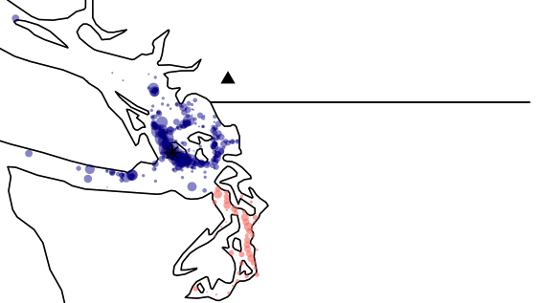
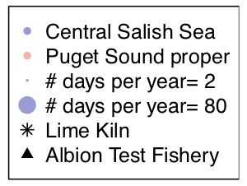
Fraser River Chinook are a prefered pray for SRKWs in the Central Salish Sea
Notes:
But not in a linear fashion…getting later of last ~20 years.
Add central salish sea
CSS: ful time series: -1.401308 (-2.004882 -0.7,)

Slide 23
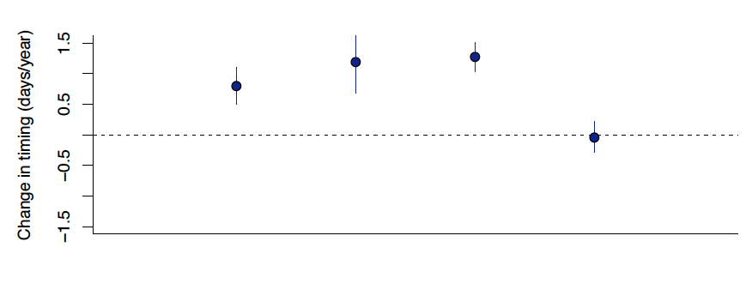
Fraser River Chinook migration timing has also delayed
Later
Earlier

Slide 24
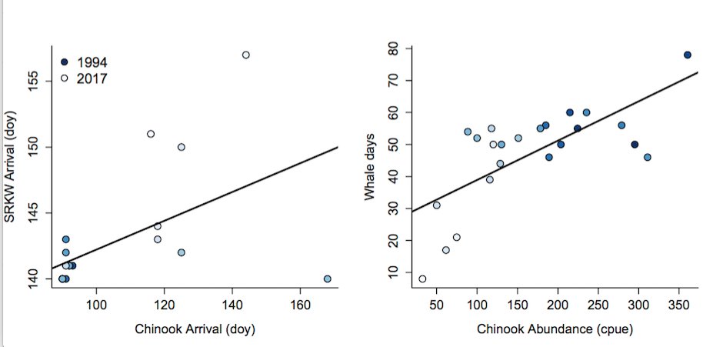
Delays in Fraser River Chinook may explain delays in SRKW in the Central Salish Sea
Notes:
But not in a linear fashion…getting later of last ~20 years.
Add central salish sea
CSS: ful time series: -1.401308 (-2.004882 -0.7,)

Slide 25
Delays in Fraser River Chinook may explain delays in SRKW in the Central Salish Sea...but have there been changes in the match/mismatch of SRKWs and their prey?
Notes:
But not in a linear fashion…getting later of last ~20 years.
Add central salish sea
CSS: ful time series: -1.401308 (-2.004882 -0.7,)

Slide 26
Delays in Fraser River Chinook may explain delays in SRKW in the Central Salish Sea...but have there been changes in the match/mismatch of SRKWs and their prey?
Notes:
But not in a linear fashion…getting later of last ~20 years.
Add central salish sea
CSS: ful time series: -1.401308 (-2.004882 -0.7,)

Slide 27
Delays in Fraser River Chinook may explain delays in SRKW in the Central Salish Sea...but have there been changes in the match/mismatch of SRKWs and their prey?
TBD…
Notes:
But not in a linear fashion…getting later of last ~20 years.
Add central salish sea
CSS: ful time series: -1.401308 (-2.004882 -0.7,)

Slide 28
No trend in peak occupancy date in Puget Sound…
Notes:
But not in a linear fashion…getting later of last ~20 years.
Add central salish sea
CSS: ful time series: -1.401308 (-2.004882 -0.7,)

Slide 29
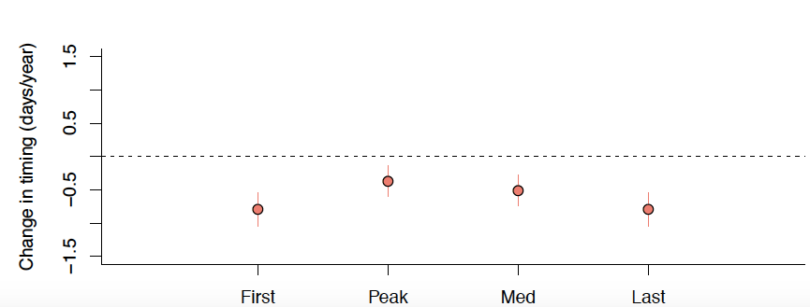
Many Puget Sound salmon have advanced
Later
Earlier

Slide 30
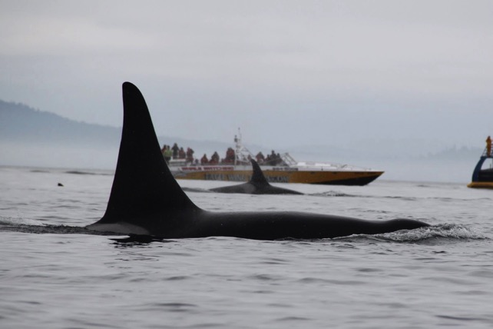
Other things have changed too…

Slide 31
Other things have changed too…
J09
J12
J13
J02

Slide 32
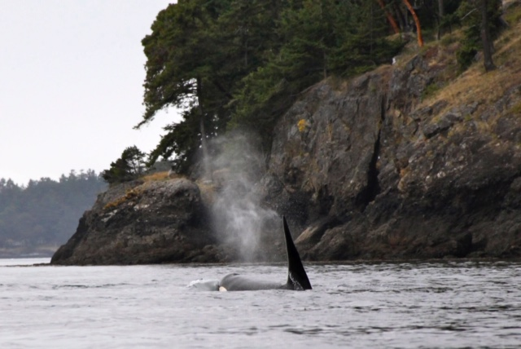
Summary
SRKW phenology has shifted, though not linearly
Recent trends (delays) differ from long-term trends
SRKWs appear to be responding to shifting phenology of their prey
Citizen science data can be useful
Absence data are useful!
There is a lot that we don’t understand about recent shifts in SRKWs and their prey…

Slide 33
Thank you!

Slide 34
Some questions…
Include both regions in a paper, or focus on the CSS (core summer habitat)?
What other figures would you want to see?

